Slide 1
Emerging Software Engineering

Slide 2
Aspect-Oriented Software Engineering

Slide 3
Aspect-Oriented Software Engineering
Aspect-oriented approach is a new paradigm which supports separation of concerns in software development.
It entails partitioning a program into distinct parts called concerns, a cohesive area of functionality.
Aspect-oriented software development (AOSD) techniques result in better implementation and have positive impact on many quality attributes such as reusability and complexity.
The crosscutting concerns cut across multiple abstractions in a program.
Crosscutting concerns are aspects of a program which affect (crosscut) other concerns. These concerns often cannot be clearly distinguished from the rest of the system, both for design and implementation.

Slide 4
Components of Aspect Orientation
Join Points
Pointcut
Advice
Introduction
Weavers
Aspect

Slide 5
Components of Aspect Orientation
Join Points
In aspect-oriented programming language, aspects are invoked only at well-defined points in program execution. These points are referred to as join points.
A join point is considered to be a location in a code where concern crosscuts to represent aspect.
Assignment statements, method or constructor call, variable references, static and dynamic initializations are a few examples of join points.
There are two types of join points, namely, static join points and dynamic join points.
A static join point is a location in the structure of a component program whereas a dynamic join point is a location in the execution of a component program.
Join point model is a representation of a conceptual framework which describes the different types of join points and associated restriction on their use.

Slide 6
Components of Aspect Orientation
Pointcut
Pointcut is a way to specify join points.
It identifies specific events with which advice should be associated.
In other words, it is a statement that defines join points where the associated aspect advice should be executed.

Slide 7
Components of Aspect Orientation
Advice
The method which executes conditionally on happening of an event is called advice.
Advice declaration is used to define the aspect code that runs at join points.
Advice consists of pointcut declaration and a body which gets executed whenever the pointcut matches.
The different types of advices are around advice, before advice, and after advice.
  Around advice: When advice code is run at a join point and it can check the conditions to control the selection of advice code, it is known as around advice.
  Before advice: When advice code is run before the method starts running, it is known as before advice.
  After advice: When advice code is run at the moment method returns the control, it is known as after advice.

Slide 8
Components of Aspect Orientation
Introduction
An introduction is a member of a type (class), but it defines or modifies a member of another type (class).
Introduction is a static crosscutting instruction that introduces changes to the classes, interfaces, and aspects of the system.
It adds fields and methods to an existing class, extends an existing class with another, and implements an interface in an existing class.
Weavers
Weavers are a specific kind of compilers used for aspect languages.
Weaver’s primary task is to transfer the aspect language program into OO program where the aspect code is inserted into the OO implementation modules.

Slide 9
Components of Aspect Orientation
Aspect
An aspect is similar to a class by having a type; it can extend classes and other aspects.
An aspect can be abstract or concrete and have fields, methods, and types as members.
Aspects are modular units of crosscutting implementation.
Aspects define precisely how behavioral and structural crosscutting has to take place by means of pointcuts (specifying fix points for behavioral crosscutting), advice (specifying code for behavioral crosscutting), and introductions (specifying code for structural crosscutting).
Just like standard UML classes, sub-aspects inherit all features from their super-aspects; they may override only ordinary Java operations and abstract pointcuts, though.
AspectJ is an aspect-oriented programming language. AspectJ extends Java with support for two kinds of crosscutting implementation

Slide 10
AOSD Process
The activities of AOSD process are as follows:
  Aspect-Oriented Requirements Engineering (AORE)
  Aspect-Oriented Architecture (AOA)
  Aspect-Oriented Design (AOD
  Aspect-Oriented Programming (AOP
  Verification of aspect-oriented programs

Slide 11
AOP Benefits and Limitations
Benefits:
  Modularize implementations of crosscutting concerns.
  Overcomes the problems caused by code tangling and code scattering.
  Addresses each concern separately with minimal coupling.
  Limitations:
  It is not well tested and documented.
  A limited amount of developing tools

Slide 12
  Usability Engineering

Slide 13
Usability
Usability is the extent to which a product can be used by the specified users to achieve the specified goals with effectiveness, efficiency, and satisfaction in a specified context of use.
Usability is a quality attribute that assesses how easy user interfaces are to use. Usability relates to how the system interacts with the user of the system.
Usability has the following five quality components:
  Ease of learning
  Efficiency of use
  Memorability
  Error frequency and severity
  Satisfaction

Slide 14
  Usability Engineering
Usability Engineering is a discipline that provides structured methods for achieving usability in user interface design during product development.
It is a methodical "engineering" approach to user interface design and evaluation, involving practical, systematic approaches to developing requirements, analyzing a usability problem, developing proposed solutions, and testing those solutions.
Usability engineering deals with design of websites, computer portals, computer keyboard design, car dashboard design, TV remote key layouts, washing machine front panel layout, etc.

Slide 15
Principles of Usability
Some of the important principles of usability are as follows:
  Visibility: It specifies what the software looks like to the user.
  Feedback: It is the response from the users. The system should send back to the user information about what action has actually been done and what result has been accomplished.
  Structure: The system should be designed in such a way that a user can easily control the system. There should be proper icons and exit points.
  Reuse: The system should be consistent so that it can be reused in other environment.
  Simplicity: System should be simple and help users to diagnose the errors and to overcome them.

Slide 16
Usability and HCI
Usability issues are not tolerable during system use especially in the case where we had never used the system or we often use a system, which is difficult and complex to use.
User interface (UI) design describes any kind of interface design of an interactive system and also the information design of non-interactive systems.
Thus, user interface design is a subset of usability engineering.
There is a difference between the visible part of the user interface (buttons, pull-down menus, checkboxes, background color, and so forth) and the interaction part of the system.
It is important to consider the design of interaction when designing the rest of the system, not just when designing the visible part of the user interface.
The development team must consider user interaction from the beginning of the development process.

Slide 17
Usability Engineering Process
Usability engineering is a set of activities that ideally take place throughout the life cycle of a product, with significant activities happening at the early stages before the user interface has even been designed.
Usability engineering approaches often have the following phases in common:
  Requirement analysis
  Conceptual model design
  Prototyping
  Implementation
  Evaluation and refinement

Slide 18
Usability Methods
User profiling
Heuristic evaluation
User scenarios
Task analysis
Prototyping
Usability testing
Usability inspection

Slide 19
Cleanroom Software Engineering

Slide 20
Introduction
Cleanroom software engineering was developed by Harlan Mills and his colleagues, at IBM Corporation’s Federal Systems Division during the early 1980s.
Cleanroom software engineering is a software development process intended to produce quality and defect free software.
Cleanroom is a team-oriented process that makes development more manageable and predictable because it is performed under statistical quality control.
It focuses on defect prevention rather than defect removal.
This approach recommends formal models for analyzing, designing, development, and testing of the software.

Slide 21
Characteristics
Incremental development: Problem is broken down into small manageable pieces, which are developed in increments that gradually increase the implemented functionality.
Formal methods for specification and hierarchical design: Cleanroom approach applies a hierarchy of box-structures method in which behavior of the system is represented in mathematical manner.
Correctness verification: The code written by developers is verified for its correctness and defect identification with the help of team reviews and inspections.
Statistical quality control: The unit testing is done as a reliability testing by independent team with the aim to keep the system as reliable as possible, i.e., maximizes the mean time to failure.

Slide 22
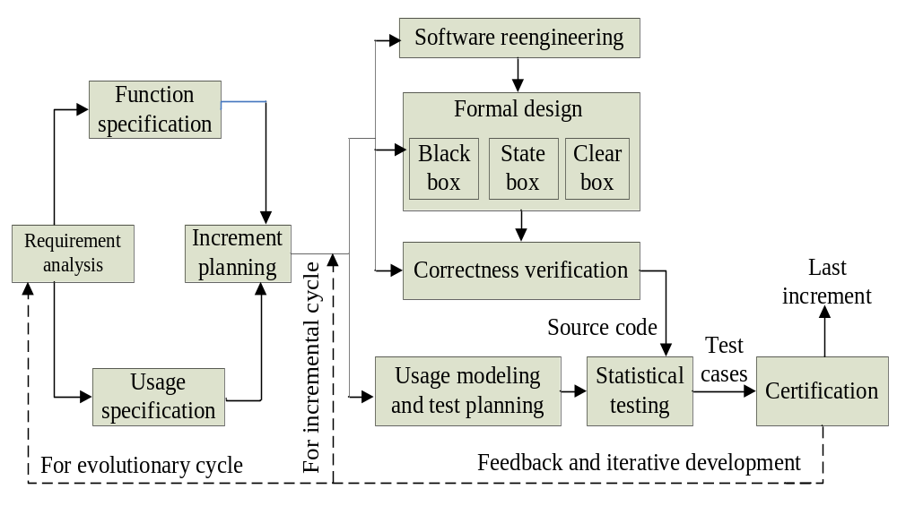
Cleanroom Process Model
Figure 15.10: Cleanroom process model

Slide 23
Phases of Cleanroom Process Model
Function specification defines the external system behavior in term of capabilities and specific behavior of the system.
Usage specification defines the use cases and their possibilities of occurrence, which is used for testing.
Increment planning: Development and certification teams together plan for incremental development.
Software reengineering: This activity is considered when any reusable component is used in the development process.
Correctness verification: The design and functionality of the developed increment is verified by design and development team with the help of formal reviews/ inspections or mathematical verification techniques to verify the correctness of software.

Slide 24
Phases of Cleanroom Process Model
Formal design
Cleanroom approach uses box structures specification method to specify system’s functionalities.
Each box encapsulates the system at some level of detail. Each box is refined into a hierarchy using stepwise refinement, where each box has referential transparency.
Box structures specification has three boxes as follows:
  Black box: It describes the externally-visible behavior of a system or a component that hides the implementation details of both data and process.
  State box: A state box refinement of a black box that specifies state data required to achieve the black box behavior.
  Clear box: It is a procedural view of state box behavior that implements the functions. It may reuse existing black boxes or introduce new black boxes for subsequent refinements.

Slide 25
Phases of Cleanroom Process Model
Box Structure Specification
Black box
Stimuli S
R Response
State box
State data
Stimuli S
R Response
Clear box
State data
+
Stimuli S
R Response
Procedure
Figure 15.11: Box structure specification

Slide 26
Phases of Cleanroom Process Model
Usage modeling and test planning: Usage models are the basis for test planning and statistical testing. A usage model is treated as a graph, where the nodes indicate events and the arcs represent transitions between events.
Statistical testing: Test cases are created from the usage models for statistical testing. This is where the software’s suitability for use is established in a format statistical experiment.
Certification: After statistical usage testing of the function, it is ready for integration. The certification team then finds mean time to failure (MTTF) in order to estimate its reliability. Samples and populations theories are used for certifications.

Slide 27
Applications, Advantages, and Limitations
There are several advantages of cleanroom process model, which include the following:
  Useful in small scale as well as large scale development
  Object-oriented development
  Novel and exceptional systems
  Embedded systems and legacy systems development
Real world Applications of cleanroom process model are: Army weapon systems, COBOL structuring facility, OS32 system for telecommunication switches, and industries etc.
In spite of the above advantages, cleanroom process model have certain limitations.
  It is too theoretical and mathematical.
  It requires intensive training
  lack of unit testing

Slide 28
Crowdsourced Software Engineering

Slide 29
Introduction
It is an emerging software engineering approach of distributed problem solving, which involves both human and machine efforts
Here, the tasks are assigned to an undefined mass of anonymous individuals, known as crowd.
Crowdsourced software engineering is the act of undertaking any external software engineering tasks by an undefined, potentially large group of online workers in an open call format.
It reduces the cost of developers; reduces time to market through collaborative and parallel development; and produces higher quality product through broad participation of the talented people.

Slide 30
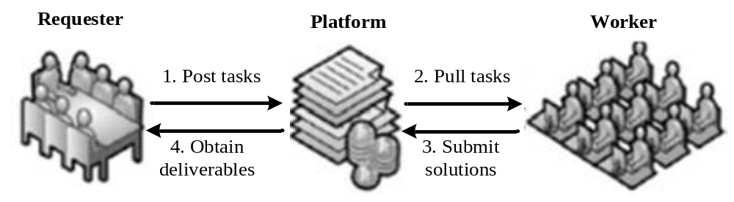
Crowdsourcing Process
Figure 15.12: Crowdsourcing process

Slide 31
Crowdsourcing Process
Crowdsourcing process involves three types of stakeholders (or components or actors), such as:
  Requesters: They are the crowdsourcer (or employers or assigners or customers or system owner), who have software tasks that need to be developed.
    They select specific internal tasks it intends to crowdsource and subsequently broadcast the underlying tasks on crowdsourcing platform.
  Workers: They are the crowd of people (crowdworkers) who respond by performing the task (i.e., developing software) or answering the question crowdsourced by requester.
  Platforms: It is the crowdsourcing marketplace (i.e., crowdsourcing intermediary) within which requesters and workers can meet.

Slide 32
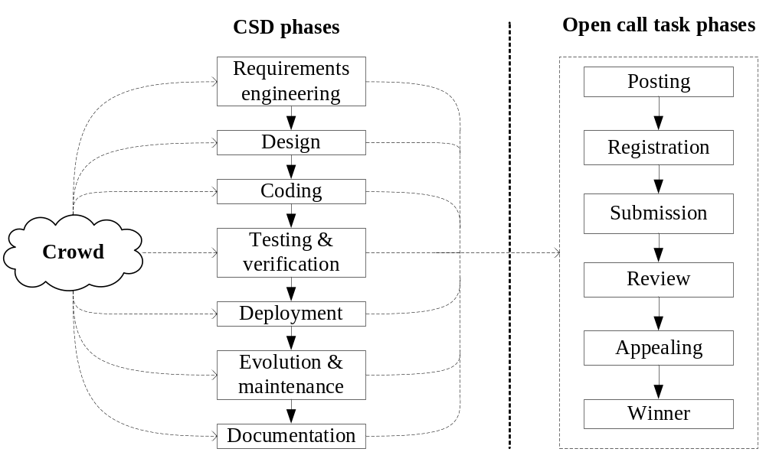
Crowdsourced Software Development
Figure 15.13: Crowdsourced software development process

Slide 33
Crowdsourced Software Development Platforms
CSD Phases | Platforms
Requirements engineering | CrowdREquire, StakeSource, StakeNet
Design | 99desings, DesignCrowd, crowdSPING, TopCoder
Coding | TopCoder, GetACoder, AppStori, Bountify, HelpMeOut, BlueFix, Calcite
Testing | uTest, 370 BugCrowd, Mob4hire, crowdMOS, Testbirds, Testbats, Pay4bugs, CrowdTesters, iTest
Verification | VeriWeb, CrowdMine, CSFV
Deployment | Crowdcloud, CloudFoundry, Salesforce.com
Evolution and maintenance | CrowdAdapt, Social Sensing, Social Sensing is Social Adaptation
Documentation | NumPy, StackOverflow
Quality assessment | QualityCrowd, CrowdPickUp
Other activities | Amazon Mechanical Turk, Guru, oDesk and Freelancer

Slide 34
Recommender Systems for Software Engineering

Slide 35
Introduction
Recommender systems have become popular due to the explosive growth of information on the web.
Recommendation tools are intensively used in e-commerce for the purpose of recommending products and services; for example, movies, books, digital cameras, or financial services.
In order to ease the performance of development activities, recommender systems for software engineering (RSSE) have been introduced.
RSSE is defined as software applications that provide information items estimated to be valuable for a software engineering task in a given context.
RSSEs provide development information (source code, artifacts, quality measures, and tools) and collaboration information (people, awareness, and status and priorities)

Slide 36
Design of Recommender System
Data preprocessing
Capturing task contexts
Recommendation engine
Presenting recommendations
Feedback
Figure 15.14: Recommender system design process

Slide 37
Components of Recommender System
Date preprocessing: It is a process of transforming raw data into interpreted format in order to detect any outlier and replacing missing values. For example, source code has to be parsed; software has to be abstracted into dependency graphs etc.
Capturing task contexts: The context is the input to RSSE that it accesses and processes in order to produce recommendations. It can be explicit, implicit or hybrid.
Recommendation engine: It is the central part of the system. It analyzes more than context data to make their recommendations and analysis of these data sources is often referred to as mining software repositories (MSR).
Presenting recommendations: It presents a recommendation of items of potential interest such as functions, classes, code examples, issue reports etc.
Feedback: It is the cross design dimension. The past recommendations support a feedback mechanism and become part of the context or data on which the RSSE operates.

Slide 38
Summary
The emerging software engineering approaches are
    Software reuse
    Aspect-oriented software engineering
    Service-oriented software engineering
    Usability engineering
    Model-driven software engineering
    Client-server software engineering
    Web engineering
    Cleanrooom software engineering
    Crowdsourced software engineering
    Recommender systems for software engineering

